Slide 1
Freshmen “Old Testament
Lesson Five
“A look at Genesis 2 and 3”

Slide 2
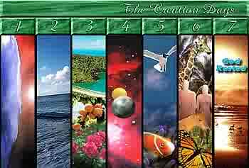
1. What is the purpose of Genesis 1?
a. To show us the “big picture” of God’s Creative work.
b. We don’t see the “detail” of how He did what He did.

Slide 3
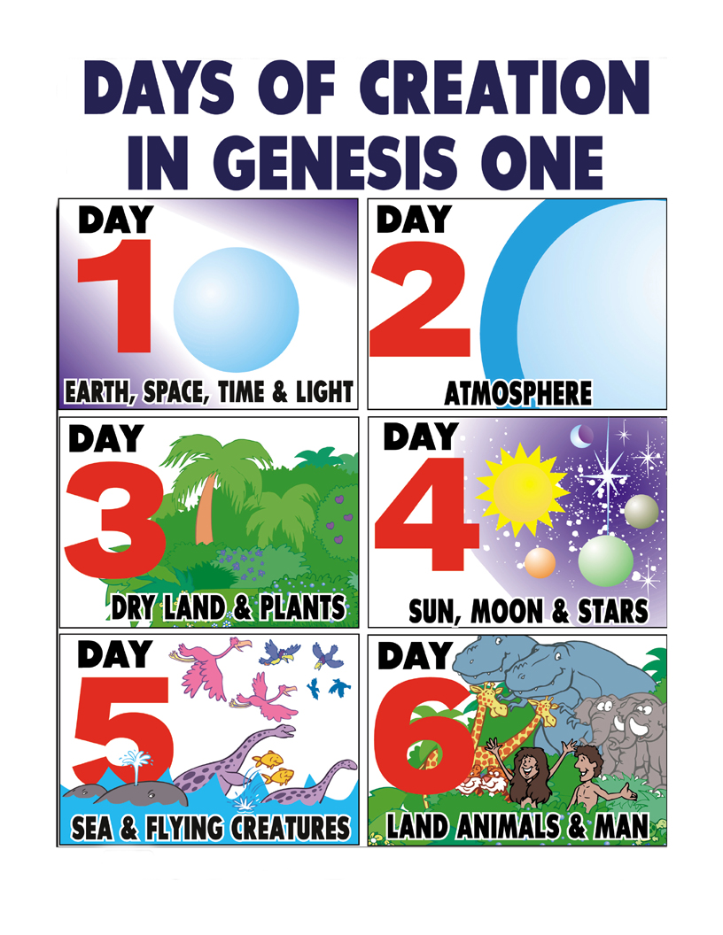
2. So what is the purpose of Genesis 2?
a.The key is in verse 4.
b.“This is the account…”
c.Same Hebrew word used in:
1) Genesis 5:1

Slide 4
2) Genesis 6:9
3) Genesis 10:1
4) Genesis 11:10
5) The word has the connotation of a family history or succession.

Slide 5
d.Therefore, Genesis Two is not actually a creation account but “a family history” of the first man and woman on the sixth day.

Slide 6
3. So Genesis Two takes a more detailed look at:

Slide 7
a.So how are we to understand Genesis 2:4b to 6?
”4b When the LORD God made the earth and the heavens- 5 and no shrub of the field had yet appeared on the earth and no plant of the field had yet sprung up, for the LORD God had not sent rain on the earth and there was no man to work the ground, 6 but streams came up from the earth and watered the whole surface of the ground- “

Slide 8
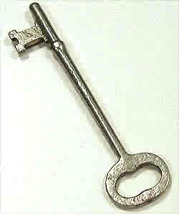
1) This is not a contradiction with Genesis 1:11.
11 Then God said, "Let the land produce vegetation: seed-bearing plants and trees on the land that bear fruit with seed in it, according to their various kinds." And it was so.
Our
2) Is found in the phrase: “of the field”.
3) The Hebrew word means: “a limited area of land and/or a flat place suitable for agriculture”.
4) In Genesis 1:11 “land” means a “broad geographic area”.

Slide 9
b.Therefore, this section of Genesis 2 is saying that there were no “cultivated” fields of shrubs and plants—no organized farms.
c. And we are told why:
1) Because there was no rain upon the earth.
2) There was no man to work the earth.

Slide 10
d.God now takes care of the situation on day six by:
1) Causing the ground to be watered.
2) Creation of man.
3) Planting a garden.
4) Putting man in the garden to take care of it.
5) He plants two special trees in the garden
6) The Tree of Life and the Tree of Knowledge of Good and Evil.

Slide 11
e.God gives man limits or boundaries in the garden.
1) He may eat from every tree except.
2) the Tree of Knowledge of Good and Evil.
3) Disobedience would be deadly.

Slide 12
f. What do you make of verse 2:18?
“18 The LORD God said, "It is not good for the man to be alone. I will make a helper suitable for him."
1) Wasn’t creation created “good” and “perfect”?
What is going on here?
2) Could it be that Adam didn’t know what God knew?

Slide 13
3) God has Adam name all of the animals.
4) What does Adam soon discover for himself?
Aa. He found no “suitable helper”.
Bb. He found no one to “correspond” with him.
Cc. He found no one with whom he could “reproduce”.

Slide 14
5) So on the “sixth day” what did God do for Adam?
Aa. He made Eve!
6. What do you think is the significance that God created Eve out of Adam’s rib?
Aa. Not his head so that she could lord it over him.

Slide 15
Bb. Not his foot so that he could lord it over her.
Cc. But from his side so that he could protect her and she would feel secure.
7) Adam’s reaction to Eve in
Genesis 2:23.
”23 The man said, “This is now bone of my bones and flesh of my flesh; she shall be called 'woman‘, for she was taken out of man."

Slide 16
Aa. Eve is not like the other animals.
Bb. Eve is “flesh and bones” like Adam.
Cc. Eve is Adam’s “own kind”.
Dd. Eve is Adam’s “suitable helper”.
8) Genesis 2:24 and God’s “institution of marriage”?
“24 For this reason a man will leave his father and mother and be united to his wife, and they will become one flesh.”

Slide 17
Aa. God’s design for marriage is a deliberate act where the man and woman break from their families to form a new family.
Bb. The married couple “unite” together in a public marriage act where they tell all that they are committed to each other.
Cc. As a married couple they seal the relationship as they express sexual intimacy and literally become one in body, mind and spirit.

Slide 18
Dd. No permission is given by God for couples to “just live together without this institution of marriage”.
Ee. No permission is given by God for sexual intimacy outside the bonds of marriage.
Ff. No permission is given by God to change the structure of marriage to include anything but a joining of a male and female.

Slide 19
9) In Genesis 2:25 we see the result of God’s design for marriage.
”25 The man and his wife were both naked, and they felt no shame.”
Aa. There was “no shame” in their relationship.
Bb. There was “no shame” in their sexual intimacy.

Slide 20
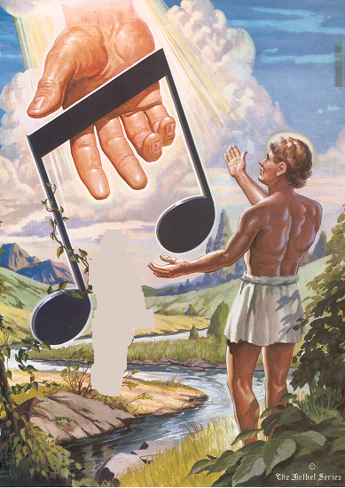

10. Using the picture to the right we will summarize what God’s creation was like before the “fall into sin”!

Slide 21
11. “Before the Fall Into Sin”
a. Note extended from Heaven:
God, because He loved, brings man into a world where he has harmony with all things
b.Four Fingers below the note bar:
1) God has harmony with man in four areas:
Aa. Extended hands of the greater figure—Harmony with God
Bb. Peaceful look on his face-
Harmony with self

Slide 22
11. “Before the Fall Into Sin”
a. Note extended from Heaven:
God, because He loved, brings man into a world where he has harmony with all things
b.Four Fingers below the note bar:
1) God has harmony with man in four areas:
Aa. Extended hands of the greater figure—Harmony with God
Bb. Peaceful look on his face-
Harmony with self

Slide 23
11. “Before the Fall Into Sin”
a. Note extended from Heaven:
God, because He loved, brings man into a world where he has harmony with all things
b.Four Fingers below the note bar:
1) God has harmony with man in four areas:
Aa. Extended hands of the greater figure—Harmony with God
Bb. Peaceful look on his face-
Harmony with self

Slide 24
11. “Before the Fall Into Sin”
a. Note extended from Heaven:
God, because He loved, brings man into a world where he has harmony with all things
b.Four Fingers below the note bar:
1) God has harmony with man in four areas:
Aa. Extended hands of the greater figure—Harmony with God
Bb. Peaceful look on his face-
Harmony with self

Slide 25
11. “Before the Fall Into Sin”
a. Note extended from Heaven:
God, because He loved, brings man into a world where he has harmony with all things
b.Four Fingers below the note bar:
1) God has harmony with man in four areas:
Aa. Extended hands of the greater figure—Harmony with God
Bb. Peaceful look on his face-
Harmony with self

Slide 26
Cc. Woman—Harmony with others
Dd. Green vine on note—Harmony with nature
c. Man facing God’s hand:
Harmony was based on obedience to God
d. Light around man’s head:
Man could respond to God’s will perfectly.

Slide 27
Cc. Woman—Harmony with others
Dd. Green vine on note—Harmony with nature
c. Man facing God’s hand:
Harmony was based on obedience to God
d. Light around man’s head:
Man could respond to God’s will perfectly.

Slide 28
Cc. Woman—Harmony with others
Dd. Green vine on note—Harmony with nature
c. Man facing God’s hand:
Harmony was based on obedience to God
d. Light around man’s head:
Man could respond to God’s will perfectly.

Slide 29
Cc. Woman—Harmony with others
Dd. Green vine on note—Harmony with nature
c. Man facing God’s hand:
Harmony was based on obedience to God
d. Light around man’s head:
Man could respond to God’s will perfectly.

Slide 30
Cc. Woman—Harmony with others
Dd. Green vine on note—Harmony with nature
c. Man facing God’s hand:
Harmony was based on obedience to God
d. Light around man’s head:
Man could respond to God’s will perfectly.

Slide 31
4.. After the Fall Into Sin
a. Genesis 3:1-8
1 Now the serpent was more crafty than any of the wild animals the LORD God had made. He said to the woman, "Did God really say, 'You must not eat from any tree in the garden'?" 2 The woman said to the serpent, "We may eat fruit from the trees in the garden, 3 but God did say, 'You must not eat fruit from the tree that is in the middle of the garden, and you must not touch it, or you will die.' " 4 "You will not surely die," the serpent said to the woman. 5 "For God knows that when you eat of it your eyes will be opened, and you will be like God, knowing good and evil." 6 When the woman saw that the fruit of the tree was good for food and…

Slide 32
…pleasing to the eye, and also desirable for gaining wisdom, she took some and ate it. She also gave some to
her husband, who was with her, and he ate it.
7 Then the eyes of both of them were opened,
and they realized they were naked; so they sewed fig leaves together and made coverings for themselves. 8 Then the man and his wife heard the sound of the LORD God as he was walking in the garden in the cool of the day, and they hid from the LORD God among the trees of the garden.

Slide 33
b. Perfection lasted for only a “season”—”short time”.
c. Satan enters the picture and you know the rest of the story:
1) Satan cast doubt on
God’s Word—“Did God really say?”
2) Satan contradicts God’s Word— ”You will not surely die.”
3) Satan makes false promises— ”You will be like God…”

Slide 34
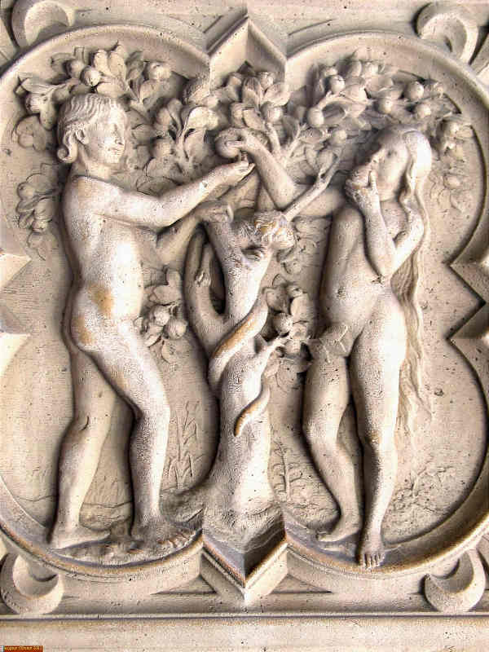
d. Adam and Eve openly and freely turned their backs on God and all that He had given to them.
“…she took some and ate it. She also gave some to her husband, who was with her, and he ate it.”

Slide 35
e. Instantly they were changed from “saint to sinner”. “…then the eyes of both of them were opened and they realized they were naked…”
1) The affects of sin are not always gradual.
2) Death (spiritual death) comes quickly.
3) “Pandora’s box” was opened and they could not shut it.

Slide 36
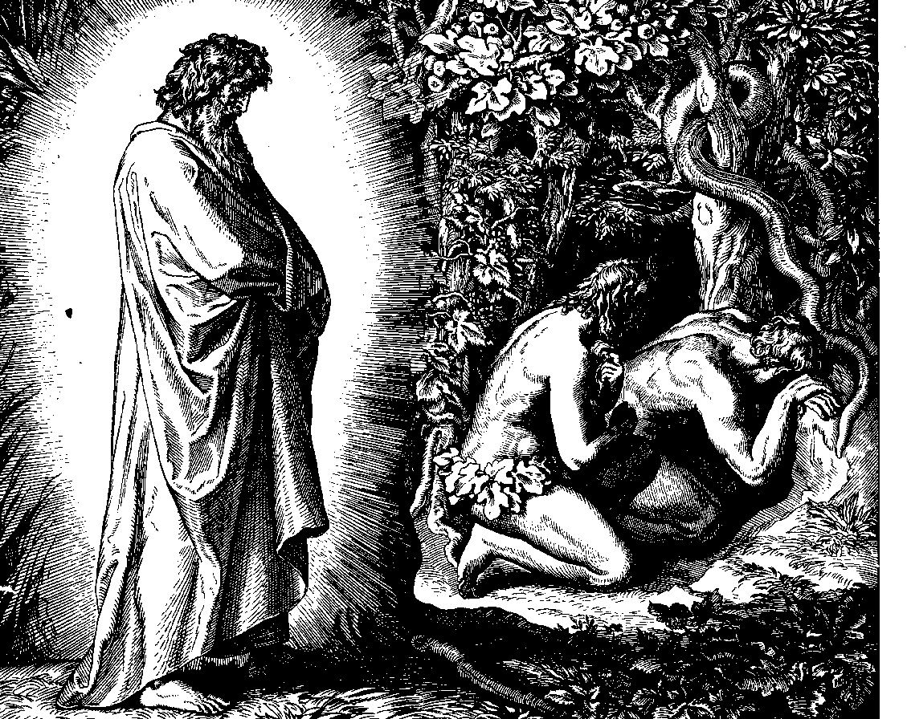
f. In their “sin” they try to hide:
1) From their nakedness by covering themselves.
2) From God by running away from Him.

Slide 37
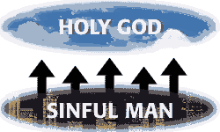
g. Romans 3:9-18
“9What shall we conclude then? Are we any better? Not at all! We have already made the charge that Jews and Gentiles alike are all under sin. 10As it is written: There is no one righteous, not even one; 11there is no one who understands, no one who seeks God. 12All have turned away, they have together become worthless; there is no one who does good, not even one."

Slide 38
13"Their throats are open graves; their tongues practice deceit." "The poison of vipers is on their lips."14"Their mouths are full of cursing and bitterness." 15"Their feet are swift to shed blood; 16 ruin and misery mark their ways,17 and the way of peace they do not know." 18"There is no fear of God before their eyes."

Slide 39
1) So how are we described?
Aa. No one is righteous.
Bb. No one understands or seeks God.
Cc. All have turned away.
Dd. No one does good.
Ee. Throats are graves.

Slide 40
Ff. Lips are poisonous.
Gg. Mouths curse and are bitter.
Hh. Quick to shed blood.
Ii. Tongues practice deceit.
Jj. Full of ruin and misery.

Slide 41
Kk.. Don’t know peace.
Ll. Don’t fear God.
This is all what we have inherited from our first parents, Adam and Eve. And we will pass this on to our children.

